Slide 1
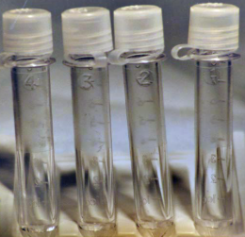

PRACTICE ALERT
CSF – Sample Collection and Laboratory Testing
Cerebrospinal Fluid (CSF) samples are collected by the physician using a lumbar puncture
Sample Collection
There are four tubes provided for the collection of CSF samples.
The etched numbers on the tubes must reflect the order of draw of the CSF
A minimum volume of 1 mL should be collected into each sterile, sequentially labelled tube (starting with tube #1 and ending with tube #4).
Laboratory Standard of Practice – Testing Protocol
Number of Tubes Received | Distribution
4 Tubes | Tube # 1 – Chemistry Tube # 2 – Cytology /Hold Tube # 3 – Microbiology Tube # 4 – Hematology
3 Tubes | Tube # 1 – Chemistry Tube # 2 – Microbiology Tube # 3 – Hematology
2 Tubes | Tube # 1 – Microbiology Tube # 2 – Chemistry/ Hematology
1 Tube | Microbiology for culture then to Integrated Laboratory for further testing.
Key Points to Remember:
The laboratory will always process CSF specimens based on the tube number, not the Meditech label numbers or handwritten numbers on the tubes.
To ensure all tests are ordered a copy of the physician order page should accompany the samples.
For more information, please contact Tracy Kichinko ext 2476
Dr. Tom Szakacs & Dr. Kathy Chorneyko

